Slide 1
Innovative test solution
Provider
- Socket List -

Slide 2
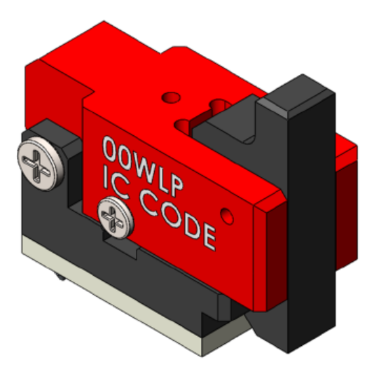
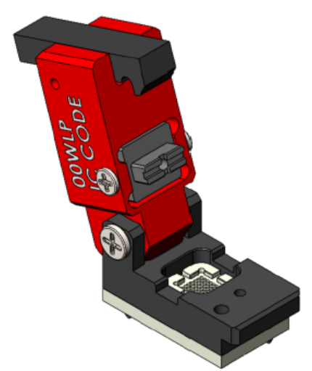
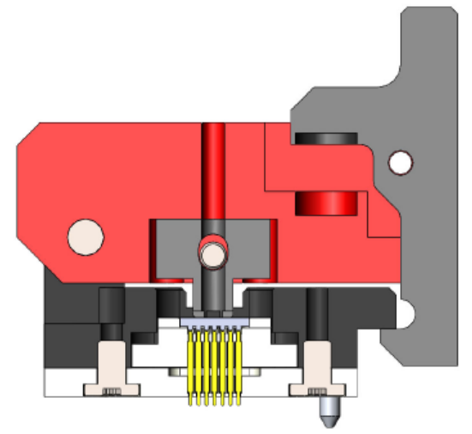
※ Socket List - Tiny
Socket name | Tiny
Maximum package size | 3.00 x 3.00
Temperature | -40 ~ 125°C
Basic material | Aluminum, Engineering plastic
Cover type | Clamshell
Test Type | Manual Test Only
Socket Size (X/Y/Z) | 19.30 x 7.90 x 17.00

Slide 3
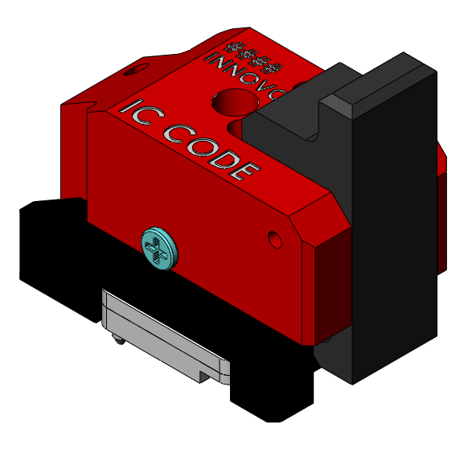
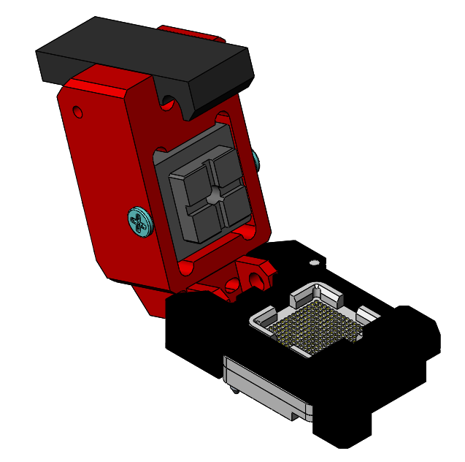
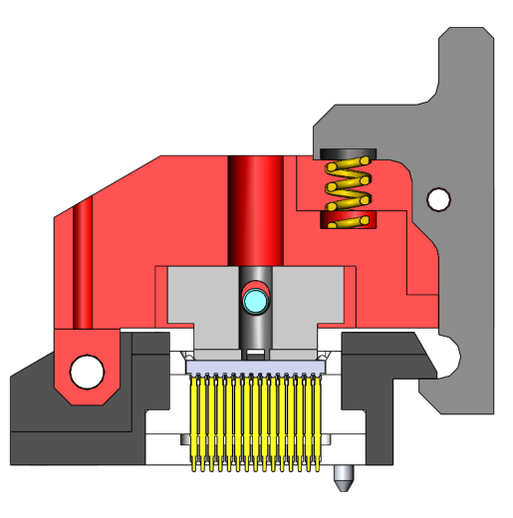
※ Socket List - Mini
Socket name | Mini
Maximum package size | 6.30 x 6.30
Temperature | -40 ~ 125°C
Basic material | Aluminum, Engineering plastic
Cover type | Clamshell
Test Type | Manual Test Only
Socket Size (X/Y/Z) | 21.925 x 10.74 x 19.80

Slide 4
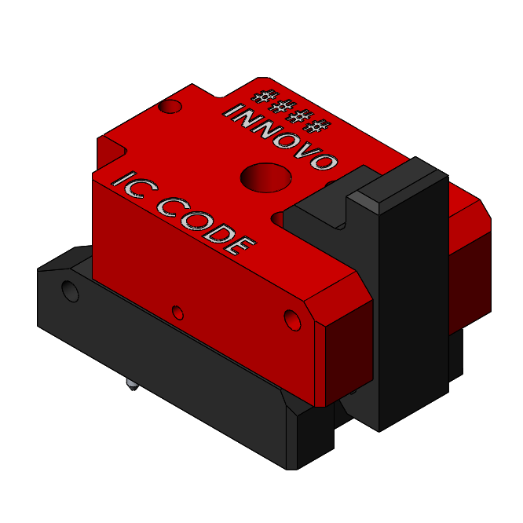
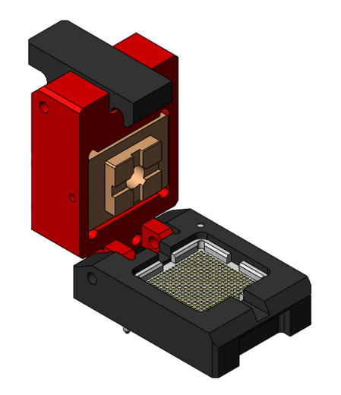
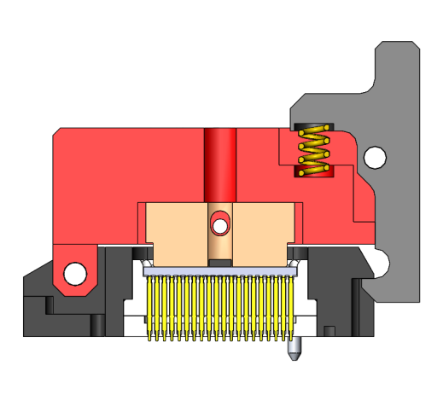
※ Socket List – Expended Mini C
Socket name | Expended Mini
Maximum package size | 10.3 x 10.3
Temperature | -40 ~ 125°C
Basic material | Aluminum, Engineering plastic
Cover type | Clamshell
Test Type | Manual Test Only
Socket Size (X/Y/Z) | 26.125 x 16.00 x 19.80

Slide 5
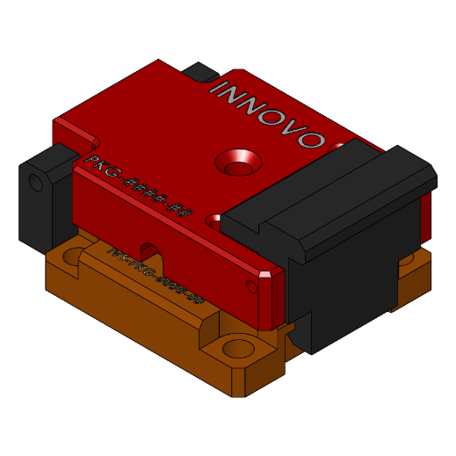
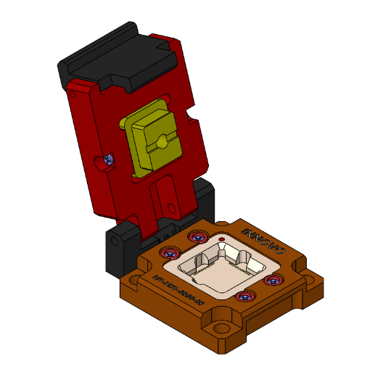
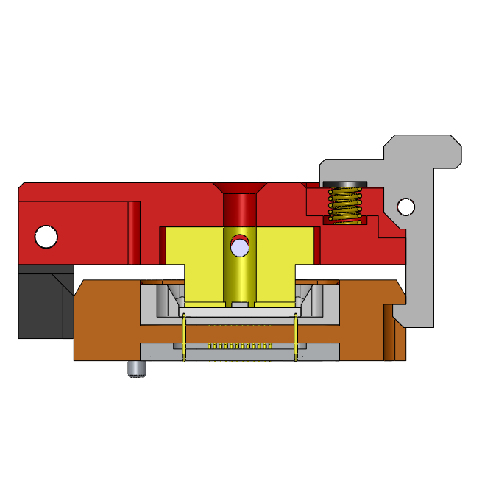
※ Socket List – Large30C
Socket name | Large 30
Maximum package size | 11.0 x 11.0
Temperature | -40 ~ 125°C
Basic material | Aluminum, Engineering plastic
Cover type | Clamshell
Test Type | Manual+Handler test available
Socket Size (X/Y/Z) | 40 x 30

Slide 6
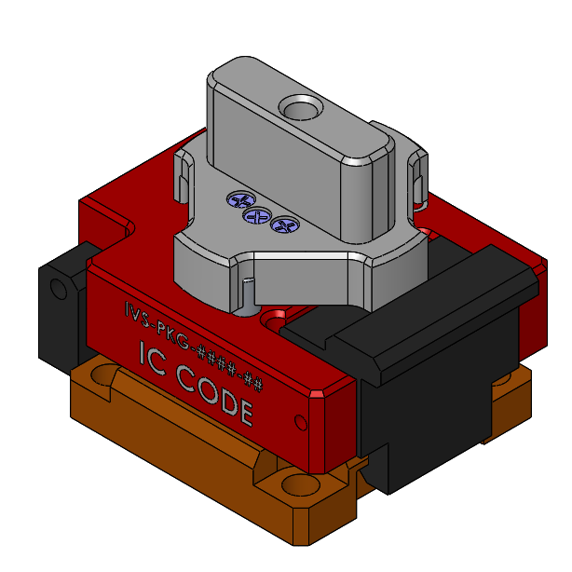
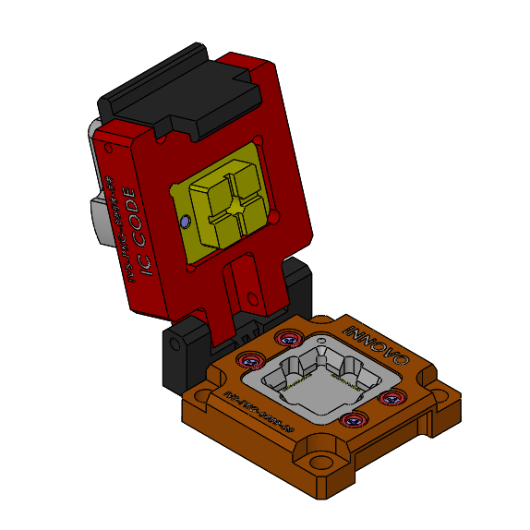
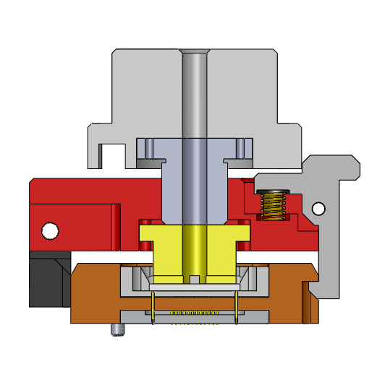
※ Socket List – Large30CH
Socket name | Large 30
Maximum package size | 11.0 x 11.0
Temperature | -40 ~ 125°C
Basic material | Aluminum, Engineering plastic
Cover type | Clamshell + Handle
Test Type | Manual+Handler test available
Socket Size (X/Y/Z) | 40 x 30

Slide 7
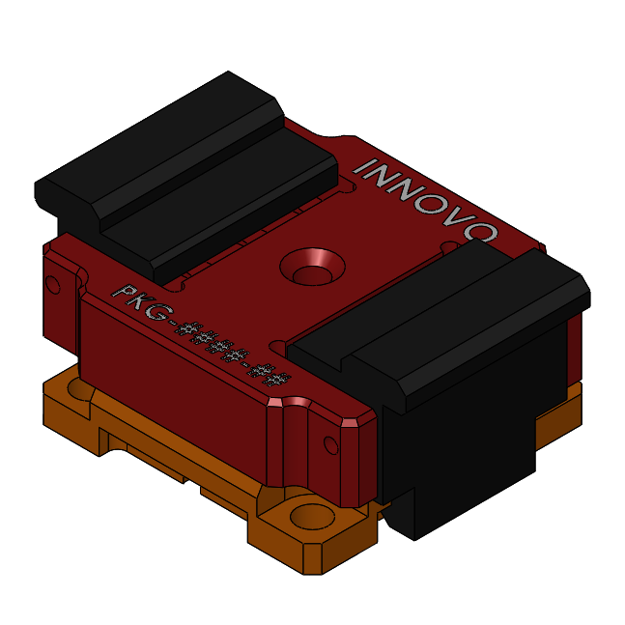
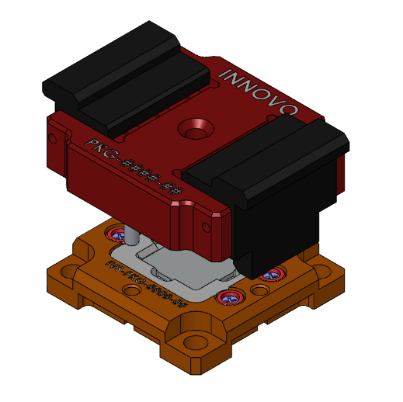
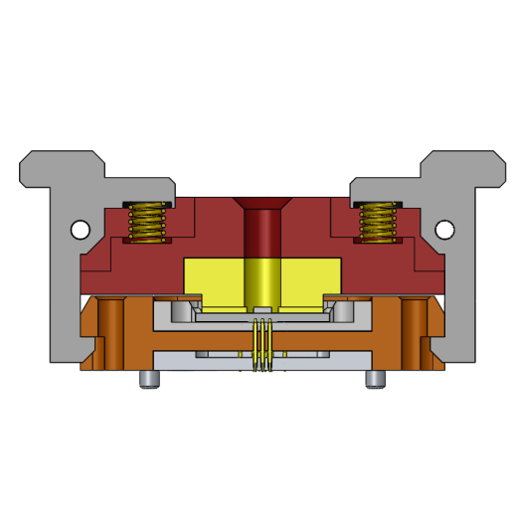
※ Socket List – Large30B
Socket name | Large 30
Maximum package size | 11.0 x 11.0
Temperature | -40 ~ 125°C
Basic material | Aluminum, Engineering plastic
Cover type | Bottle Cap
Test Type | Manual+Handler test available
Socket Size (X/Y/Z) | 40 x 30

Slide 8
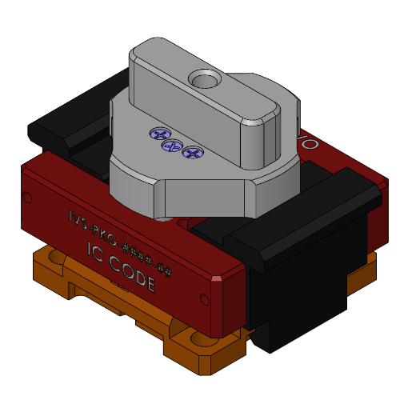
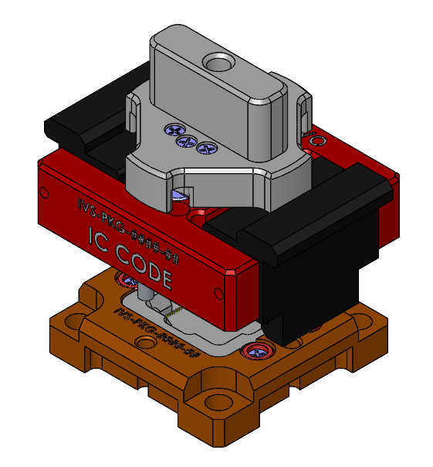
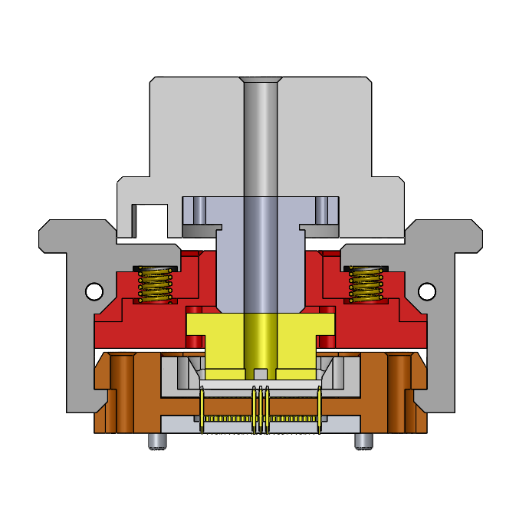
※ Socket List – Large30BH
Socket name | Large 30
Maximum package size | 11.0 x 11.0
Temperature | -40 ~ 125°C
Basic material | Aluminum, Engineering plastic
Cover type | Bottle Cap + Handle
Test Type | Manual+Handler test available
Socket Size (X/Y/Z) | 40 x 30

Slide 9
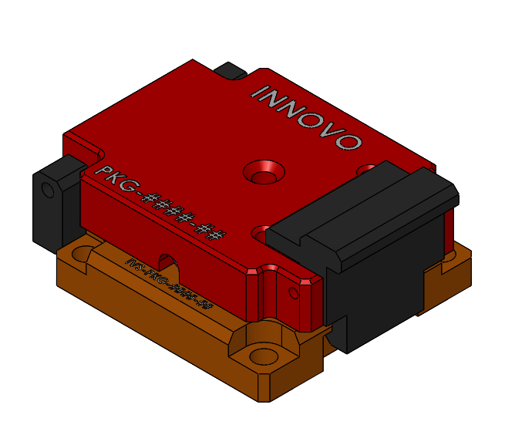
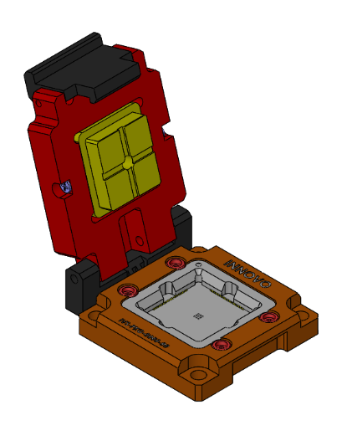
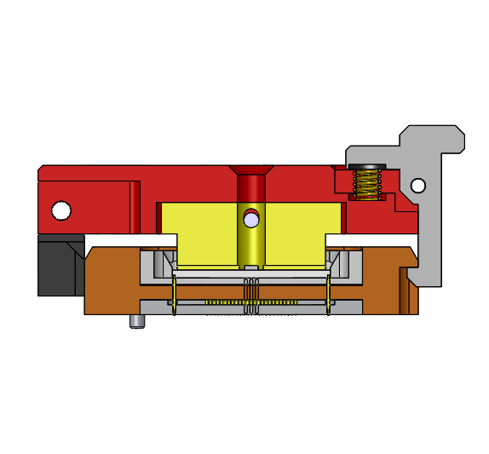
※ Socket List – Large36C
Socket name | Large 36
Maximum package size | 17.0 x 17.0
Temperature | -40 ~ 125°C
Basic material | Aluminum, Engineering plastic
Cover type | Clamshell
Test Type | Manual+Handler test available
Socket Size (X/Y/Z) | 46 X 36

Slide 10
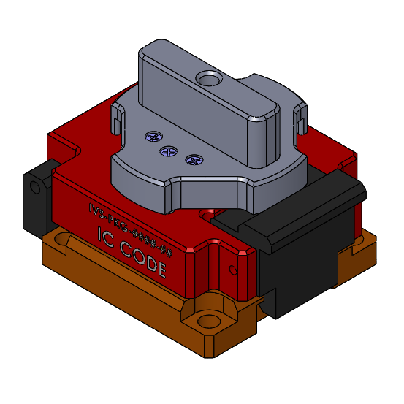
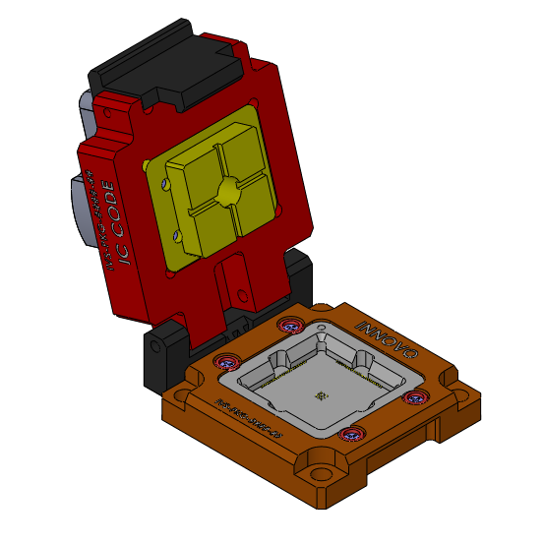
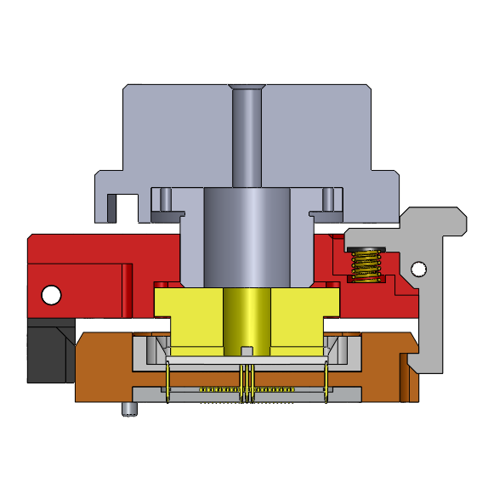
※ Socket List – Large36CH
Socket name | Large 36
Maximum package size | 17.0 x 17.0
Temperature | -40 ~ 125°C
Basic material | Aluminum, Engineering plastic
Cover type | Clamshell + Handle
Test Type | Manual+Handler test available
Socket Size (X/Y/Z) | 46 X 36

Slide 11
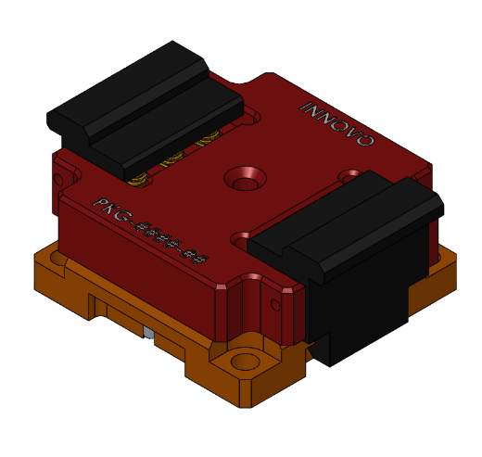
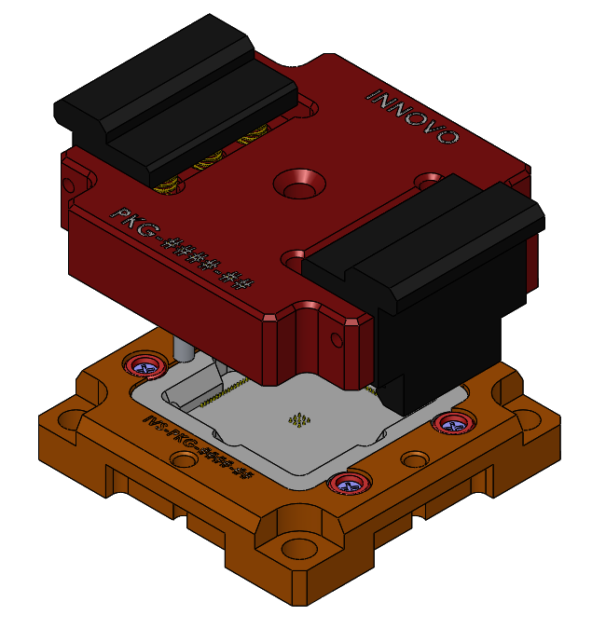
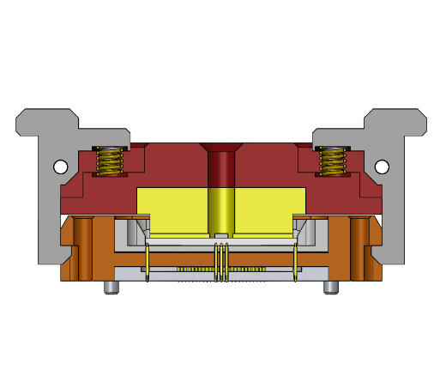
※ Socket List – Large36B
Socket name | Large 36
Maximum package size | 17.0 x 17.0
Temperature | -40 ~ 125°C
Basic material | Aluminum, Engineering plastic
Cover type | Bottle Cap
Test Type | Manual+Handler test available
Socket Size (X/Y/Z) | 46 X 36

Slide 12
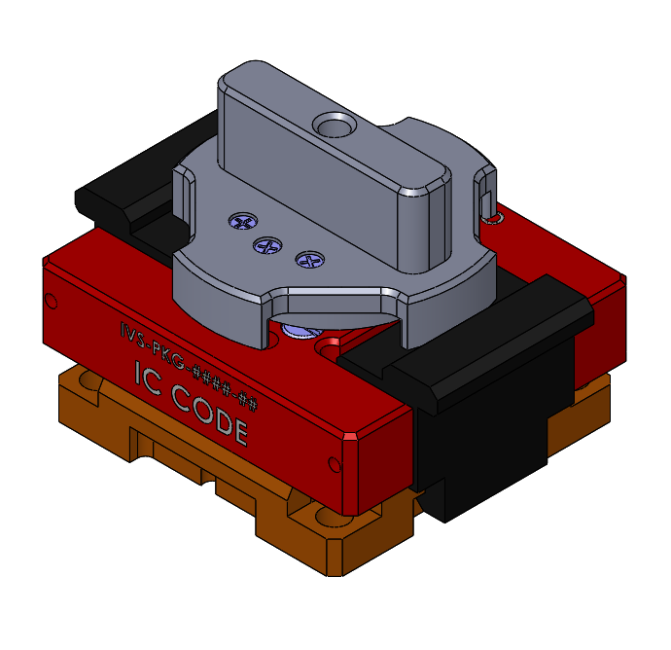
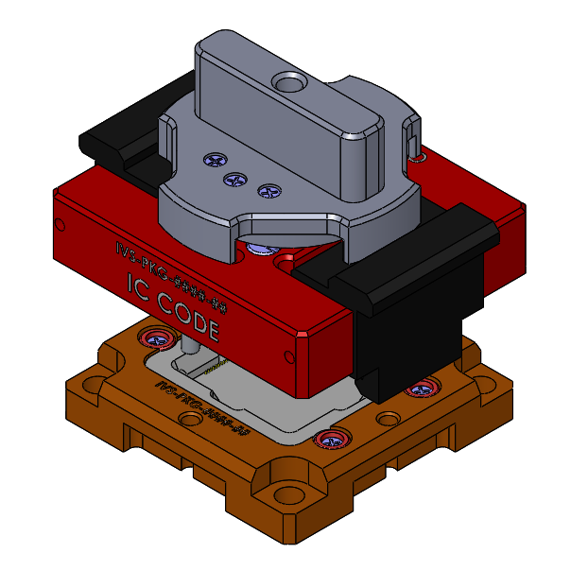
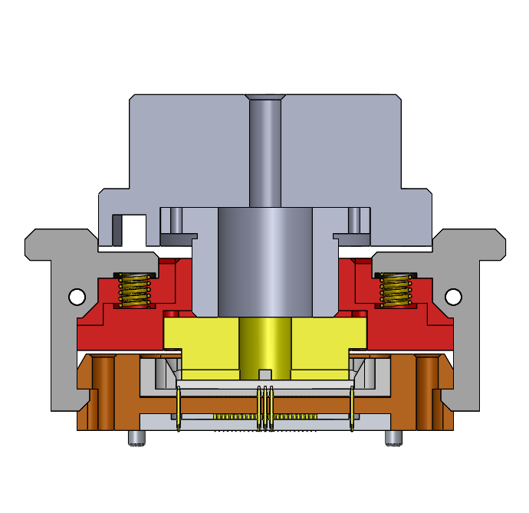
※ Socket List – Large36BH
Socket name | Large 36
Maximum package size | 17.0 x 17.0
Temperature | -40 ~ 125°C
Basic material | Aluminum, Engineering plastic
Cover type | Bottle Cap + Handle
Test Type | Manual+Handler test available
Socket Size (X/Y/Z) | 46 X 36

Slide 13
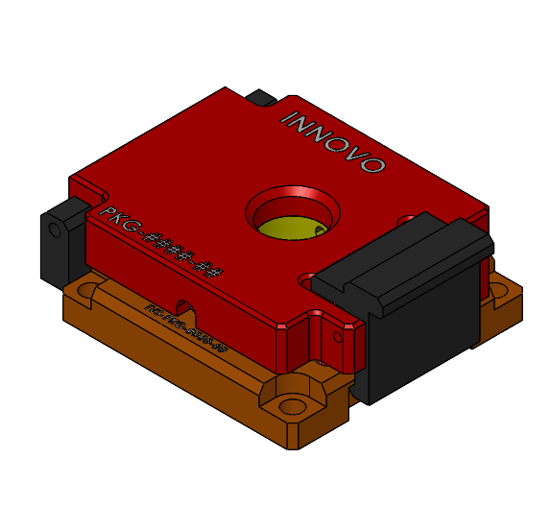
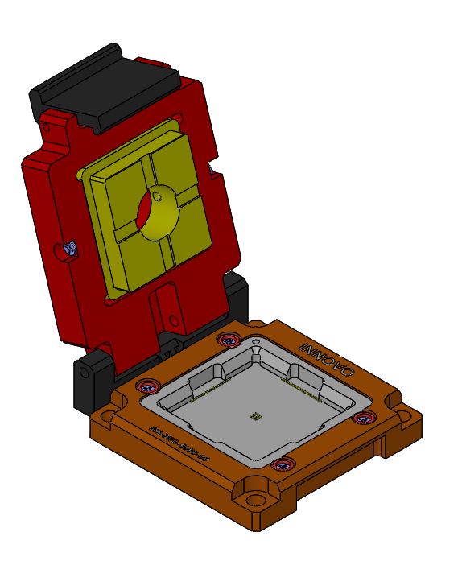
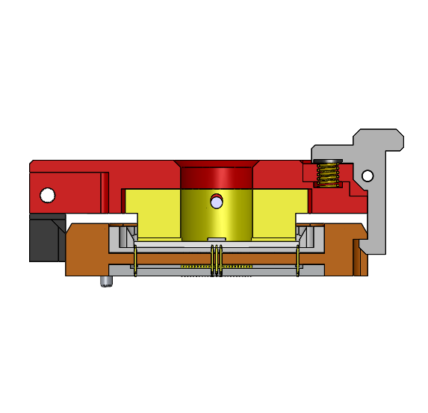
※ Socket List – Large42C
Socket name | Large 42
Maximum package size | 23.0 x 23.0
Temperature | -40 ~ 125°C
Basic material | Aluminum, Engineering plastic
Cover type | Clamshell
Test Type | Manual+Handler test available
Socket Size (X/Y/Z) | 52 X 42

Slide 14
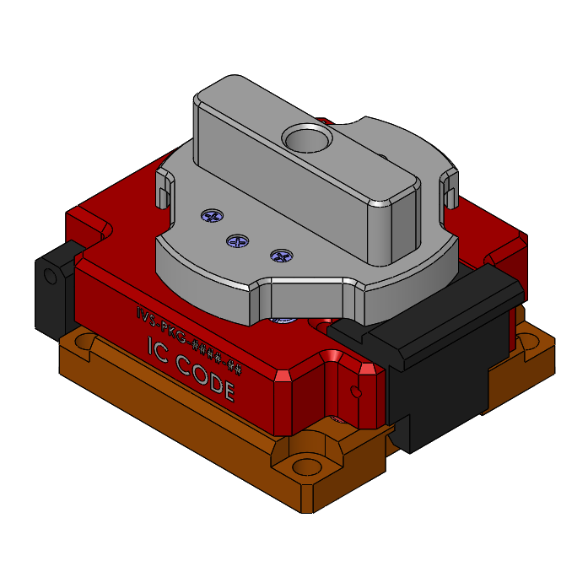
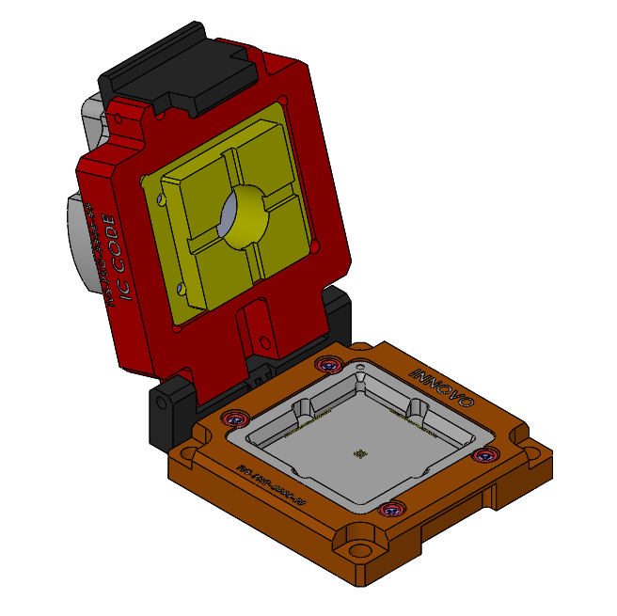
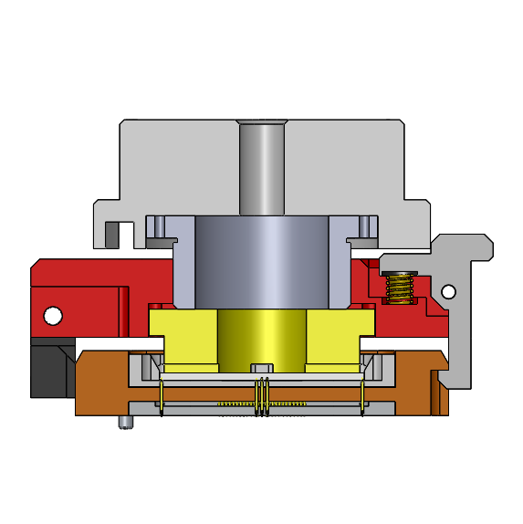
※ Socket List – Large42CH
Socket name | Large 42
Maximum package size | 23.0 x 23.0
Temperature | -40 ~ 125°C
Basic material | Aluminum, Engineering plastic
Cover type | Clamshell + Handle
Test Type | Manual+Handler test available
Socket Size (X/Y/Z) | 52 X 42

Slide 15
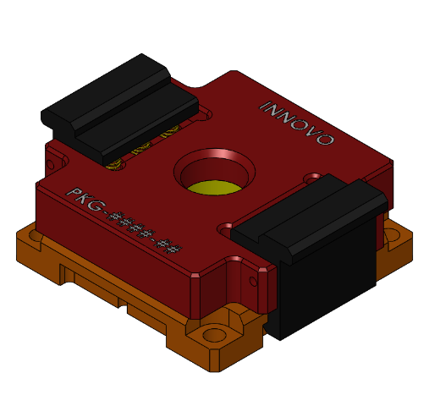
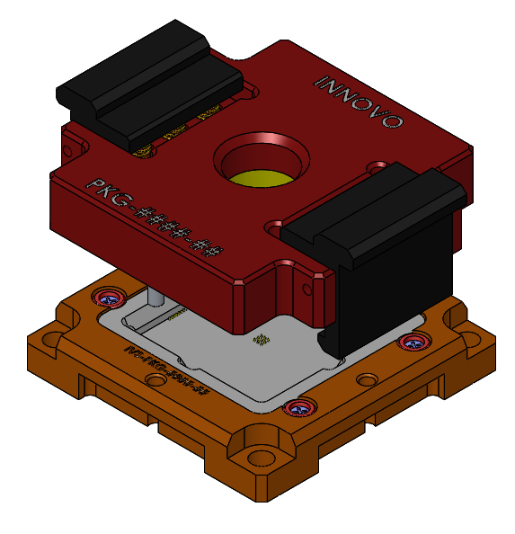
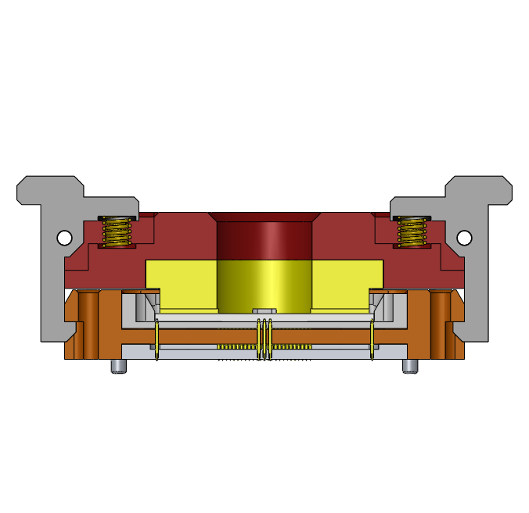
※ Socket List – Large42B
Socket name | Large 42
Maximum package size | 23.0 x 23.0
Temperature | -40 ~ 125°C
Basic material | Aluminum, Engineering plastic
Cover type | Bottle Cap
Test Type | Manual+Handler test available
Socket Size (X/Y/Z) | 52 X 42

Slide 16
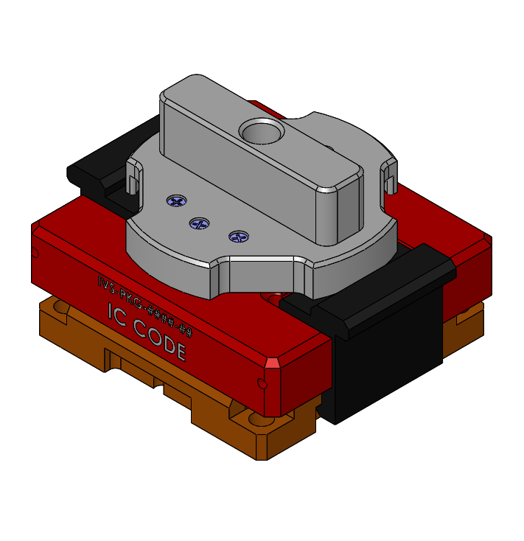
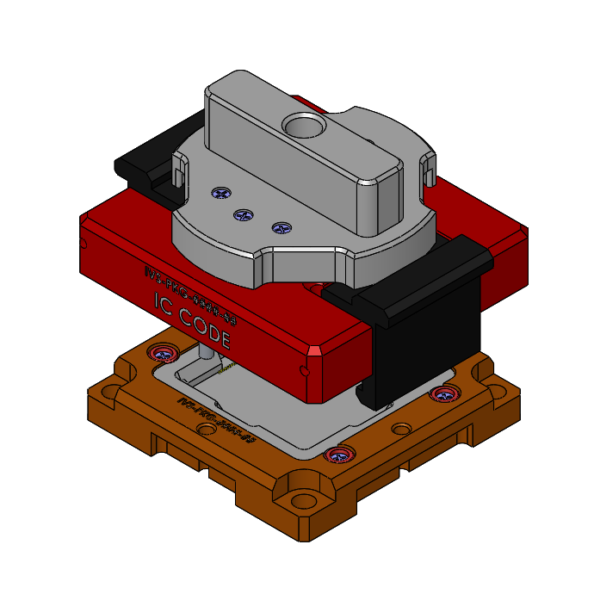
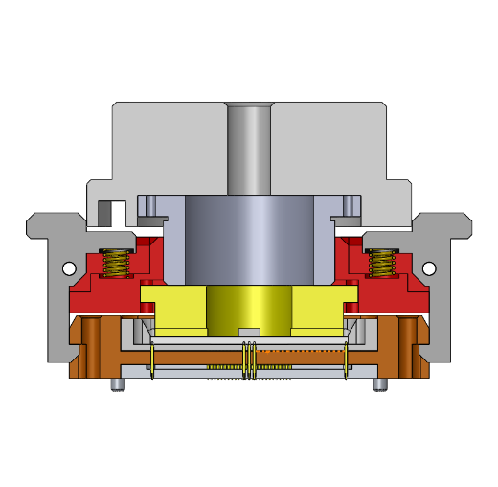
※ Socket List – Large42BH
Socket name | Large 42
Maximum package size | 23.0 x 23.0
Temperature | -40 ~ 125°C
Basic material | Aluminum, Engineering plastic
Cover type | Bottle Cap + Handle
Test Type | Manual+Handler test available
Socket Size (X/Y/Z) | 52 X 42

Slide 17
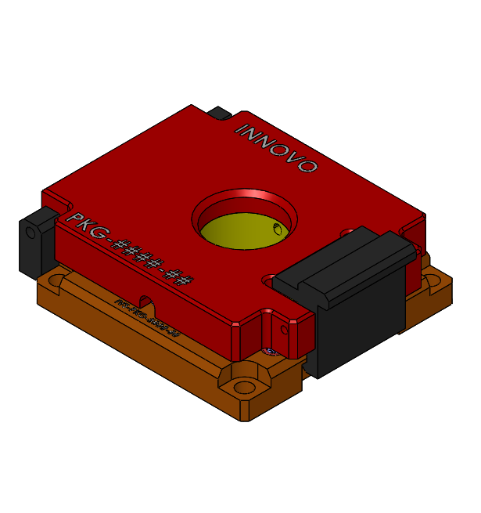
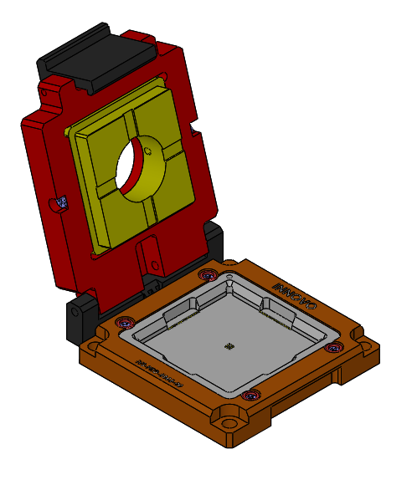
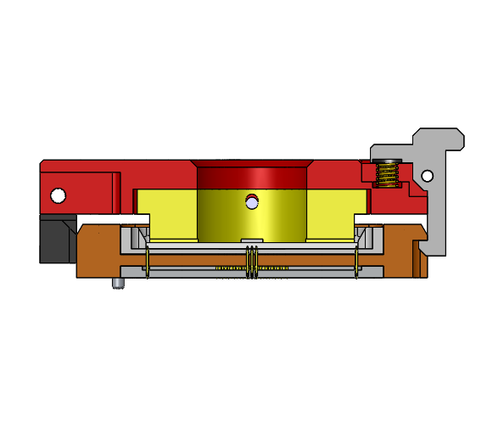
※ Socket List – Large48C
Socket name | Large48C
Maximum package size | 29.0 x 29.0
Temperature | -40 ~ 125°C
Basic material | Aluminum, Engineering plastic
Cover type | Clamshell
Test Type | Manual+Handler test available
Socket Size (X/Y/Z) | 58 X 48

Slide 18
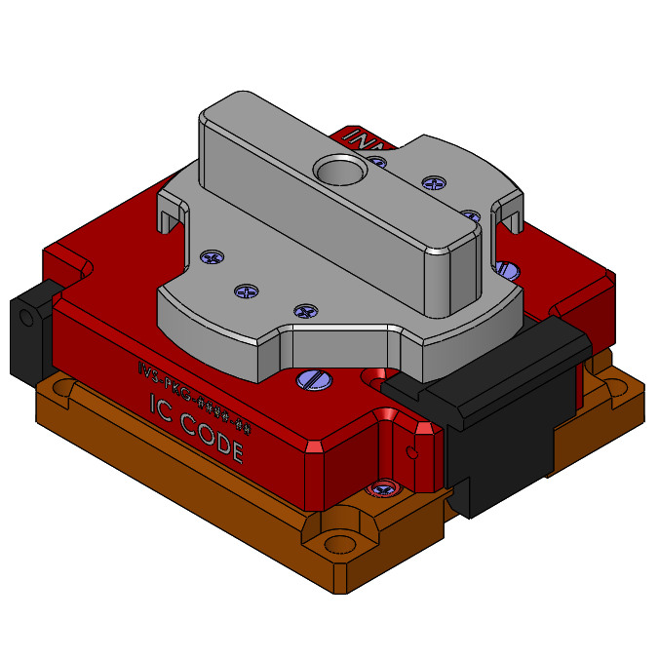
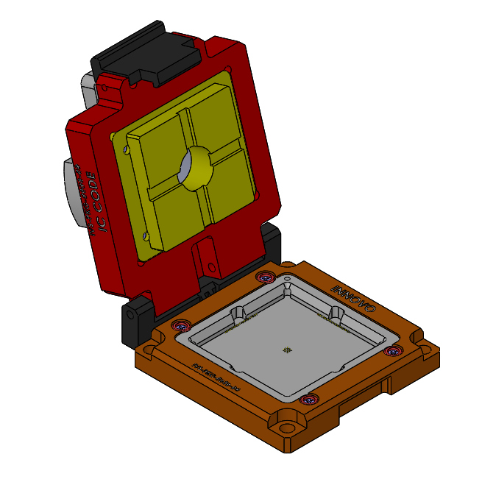

※ Socket List – Large48CH
Socket name | Large48CH
Maximum package size | 29.0 x 29.0
Temperature | -40 ~ 125°C
Basic material | Aluminum, Engineering plastic
Cover type | Clamshell + Handle
Test Type | Manual+Handler test available
Socket Size (X/Y/Z) | 58 X 48

Slide 19



※ Socket List – Large48B
Socket name | Large48B
Maximum package size | 29.0 x 29.0
Temperature | -40 ~ 125°C
Basic material | Aluminum, Engineering plastic
Cover type | Bottle Cap
Test Type | Manual+Handler test available
Socket Size (X/Y/Z) | 58 X 48

Slide 20



※ Socket List – Large48BH
Socket name | Large48BH
Maximum package size | 29.0 x 29.0
Temperature | -40 ~ 125°C
Basic material | Aluminum, Engineering plastic
Cover type | Bottle Cap + Handle
Test Type | Manual+Handler test available
Socket Size (X/Y/Z) | 58 X 48

Slide 21



※ Socket List – WLCSP
Socket name | WLCSP
Maximum package size | All kind of IC supported
Temperature | -40 ~ 125°C
Basic material | Aluminum, Engineering plastic
Cover type | NONE
Test Type | Handler only
Socket Size (X/Y/Z) | Changeable to IC size and number of arrays

Slide 22



※ Socket List – Multi
Socket name | Multi
Maximum package size | All kind of IC supported
Temperature | -40 ~ 125°C
Basic material | Aluminum, Engineering plastic
Cover type | Clamshell
Test Type | Manual test only
Socket Size (X/Y/Z) | Changeable to IC size and number of arrays

Slide 23



※ Socket List – Magnetic_M
Socket name | Magnetic_M
Maximum package size | All kind of IC supported
Temperature | -40 ~ 125°C
Basic material | Aluminum, Engineering plastic
Cover type | Bottle Cap
Test Type | Manual test only
Socket Size (X/Y/Z) | Changeable to IC size and number of arrays

Slide 24



※ Socket List – Magnetic_H
Socket name | Magnetic_H
Maximum package size | All kind of IC supported
Temperature | -40 ~ 125°C
Basic material | Aluminum, Engineering plastic
Cover type | Bottle Cap
Test Type | Handler test only
Socket Size (X/Y/Z) | Changeable to IC size and number of arrays

Slide 25
Thank you.
InnovoSolution Co., Ltd.
12, Galmachi-ro 203beon-gil, Jungwon-gu, Seongnam-si, Gyeonggi-do, Republic of Korea
Indy (SB) Chung .
Director .
Phone: +82-10-2850-9025
Fax: +82-31-735-6145 .

